Slide 1
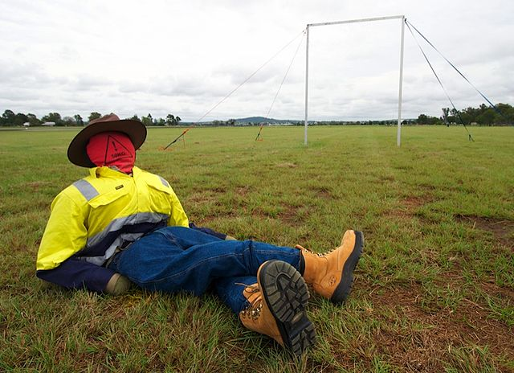
Rescuing Joe

Slide 2
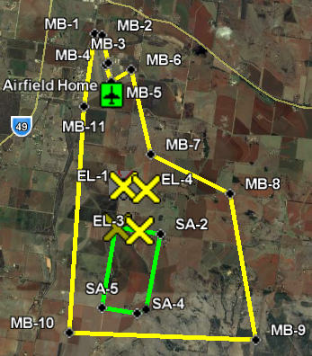
Outback Challenge
Search for lost bushwalker
  Kingaroy, Queensland in September
  53 teams, 10 countries
  2.2 by 1.2 km search
  1 hour for 68 km flight
  computer vision/search
  fully automatic flight
  auto takeoff/land
  geo-fencing
  documented safety system
  drop water bottle
    don't hit Joe!

Slide 3
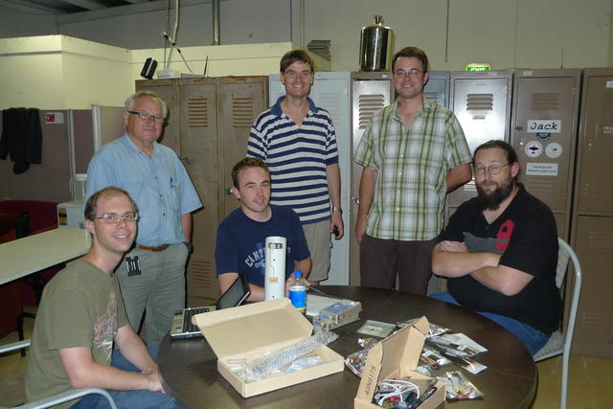
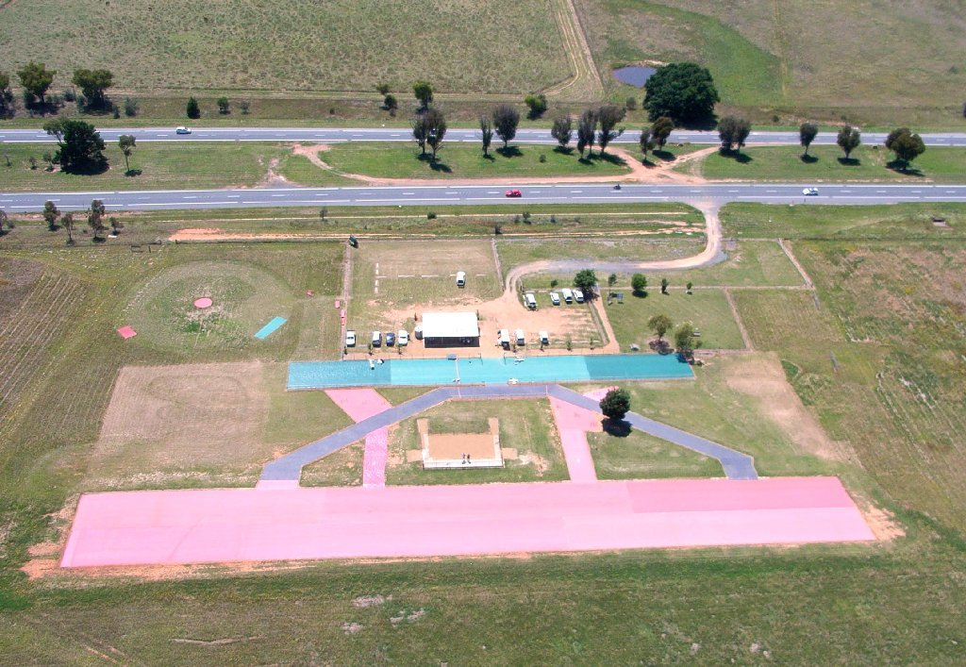
CanberraUAV
Diverse team
  aeromodelling
  amateur radio
  electronics
  computer vision
  software
Open project
  All code and schematics released
Affiliations
  Canberra Model Aircraft Club
  Dickson College school team
  MakeHackVoid hackerspace

Slide 4
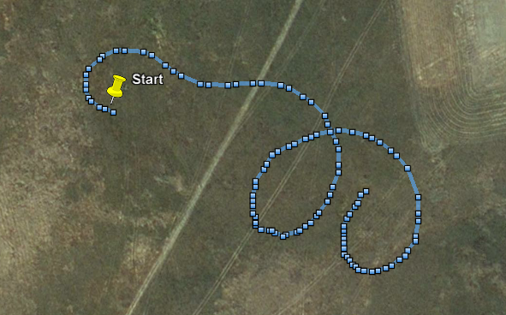
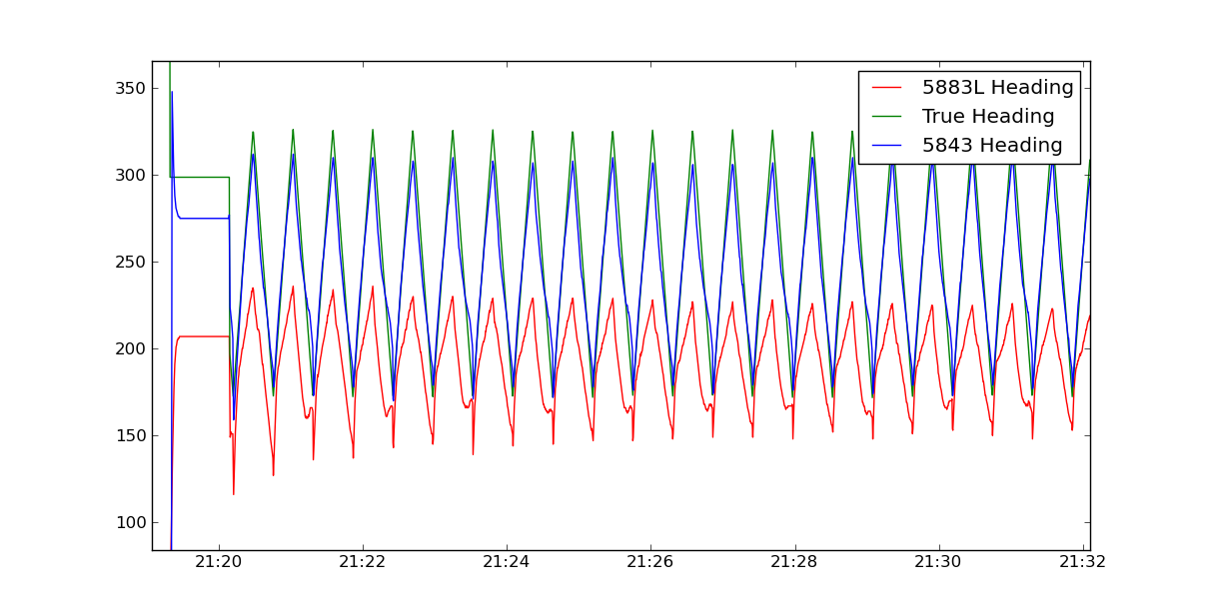
Technical Challenges
Not an easy task!
  building airframe
  autopilot
  navigation
  accurate sensors
  reliable radio links
  machine vision
  camera control
  ground station
  vibration control

Slide 5
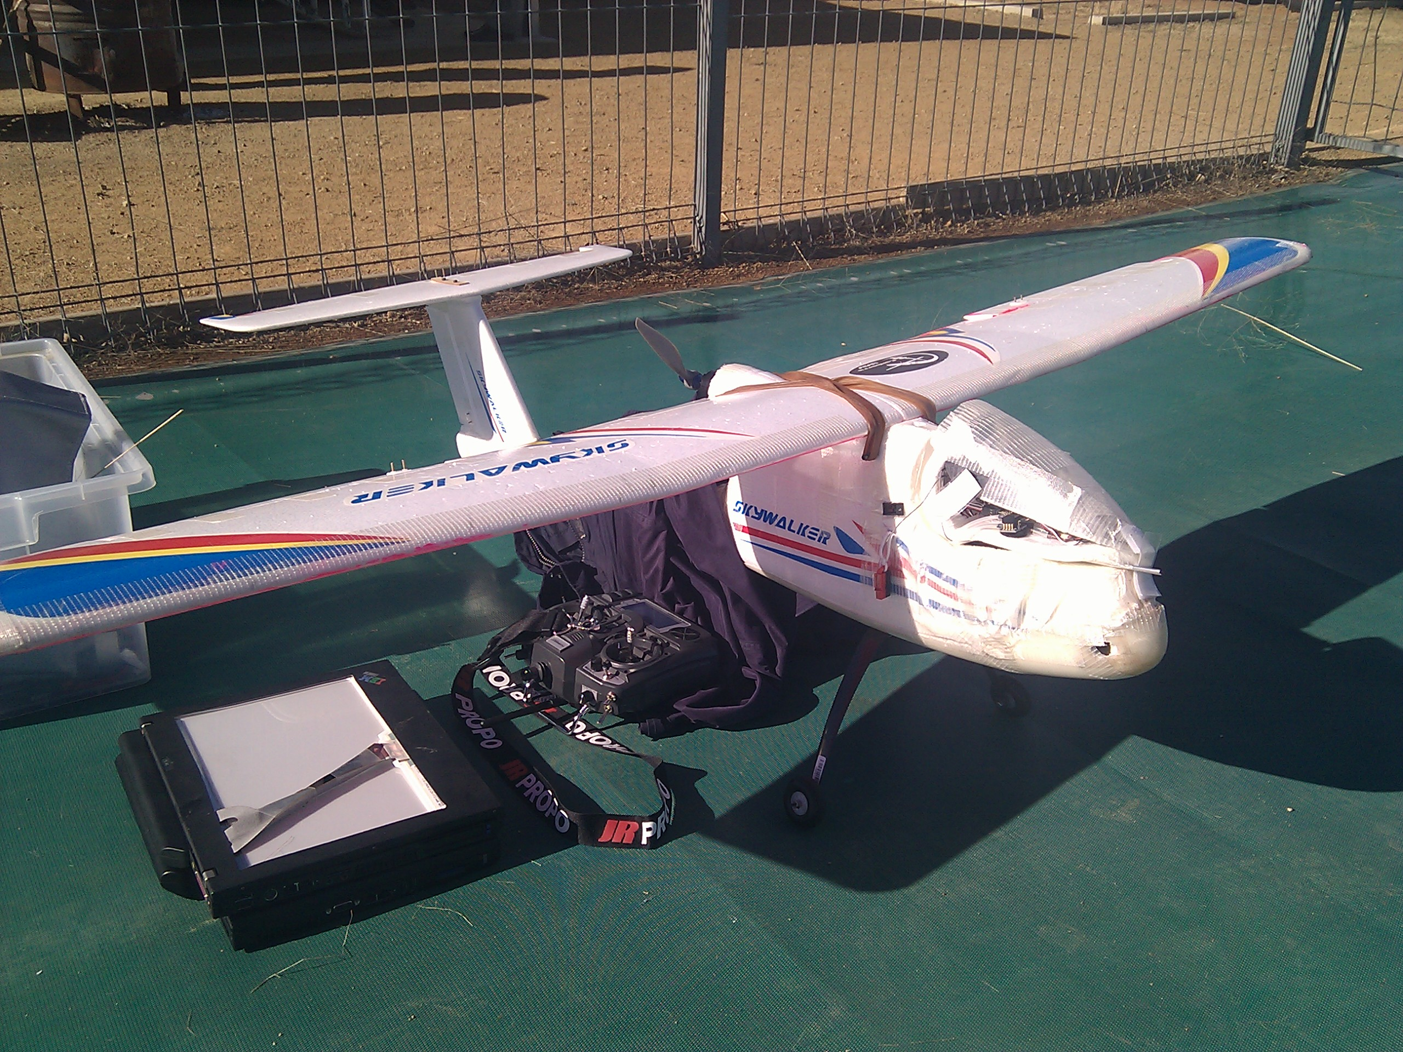
SkyWalker
Early test plane
  1.7m wingspan
  2.5 kilograms
  electric
  1 hour flights
  easy/slow flight

Slide 6
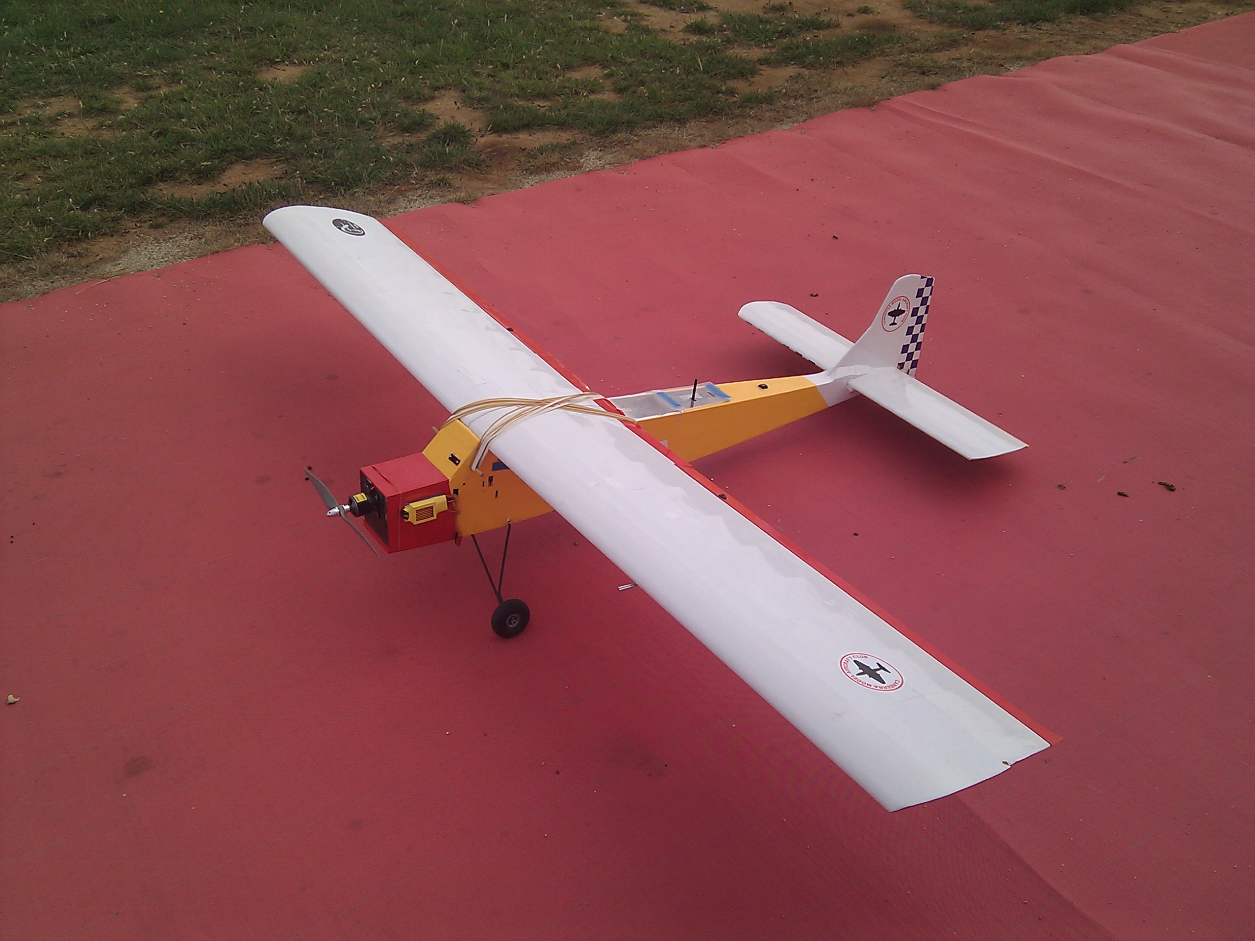
Senior Telemaster
Test workhorse
  8 foot wingspan
  7 kilograms
  electric
  30 minutes flight

Slide 7
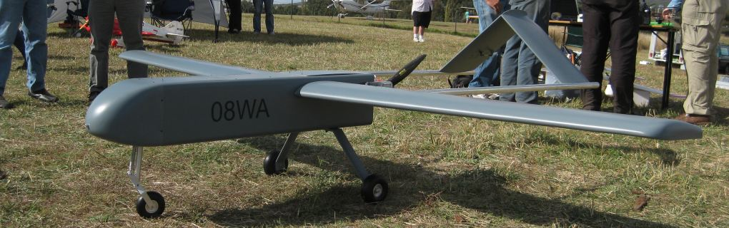
Mugin (CyberHawk)
Competition airframe
  3m wingspan
  20 kg takeoff weight
  50cc petrol motor
  ~3hrs flight time

Slide 8
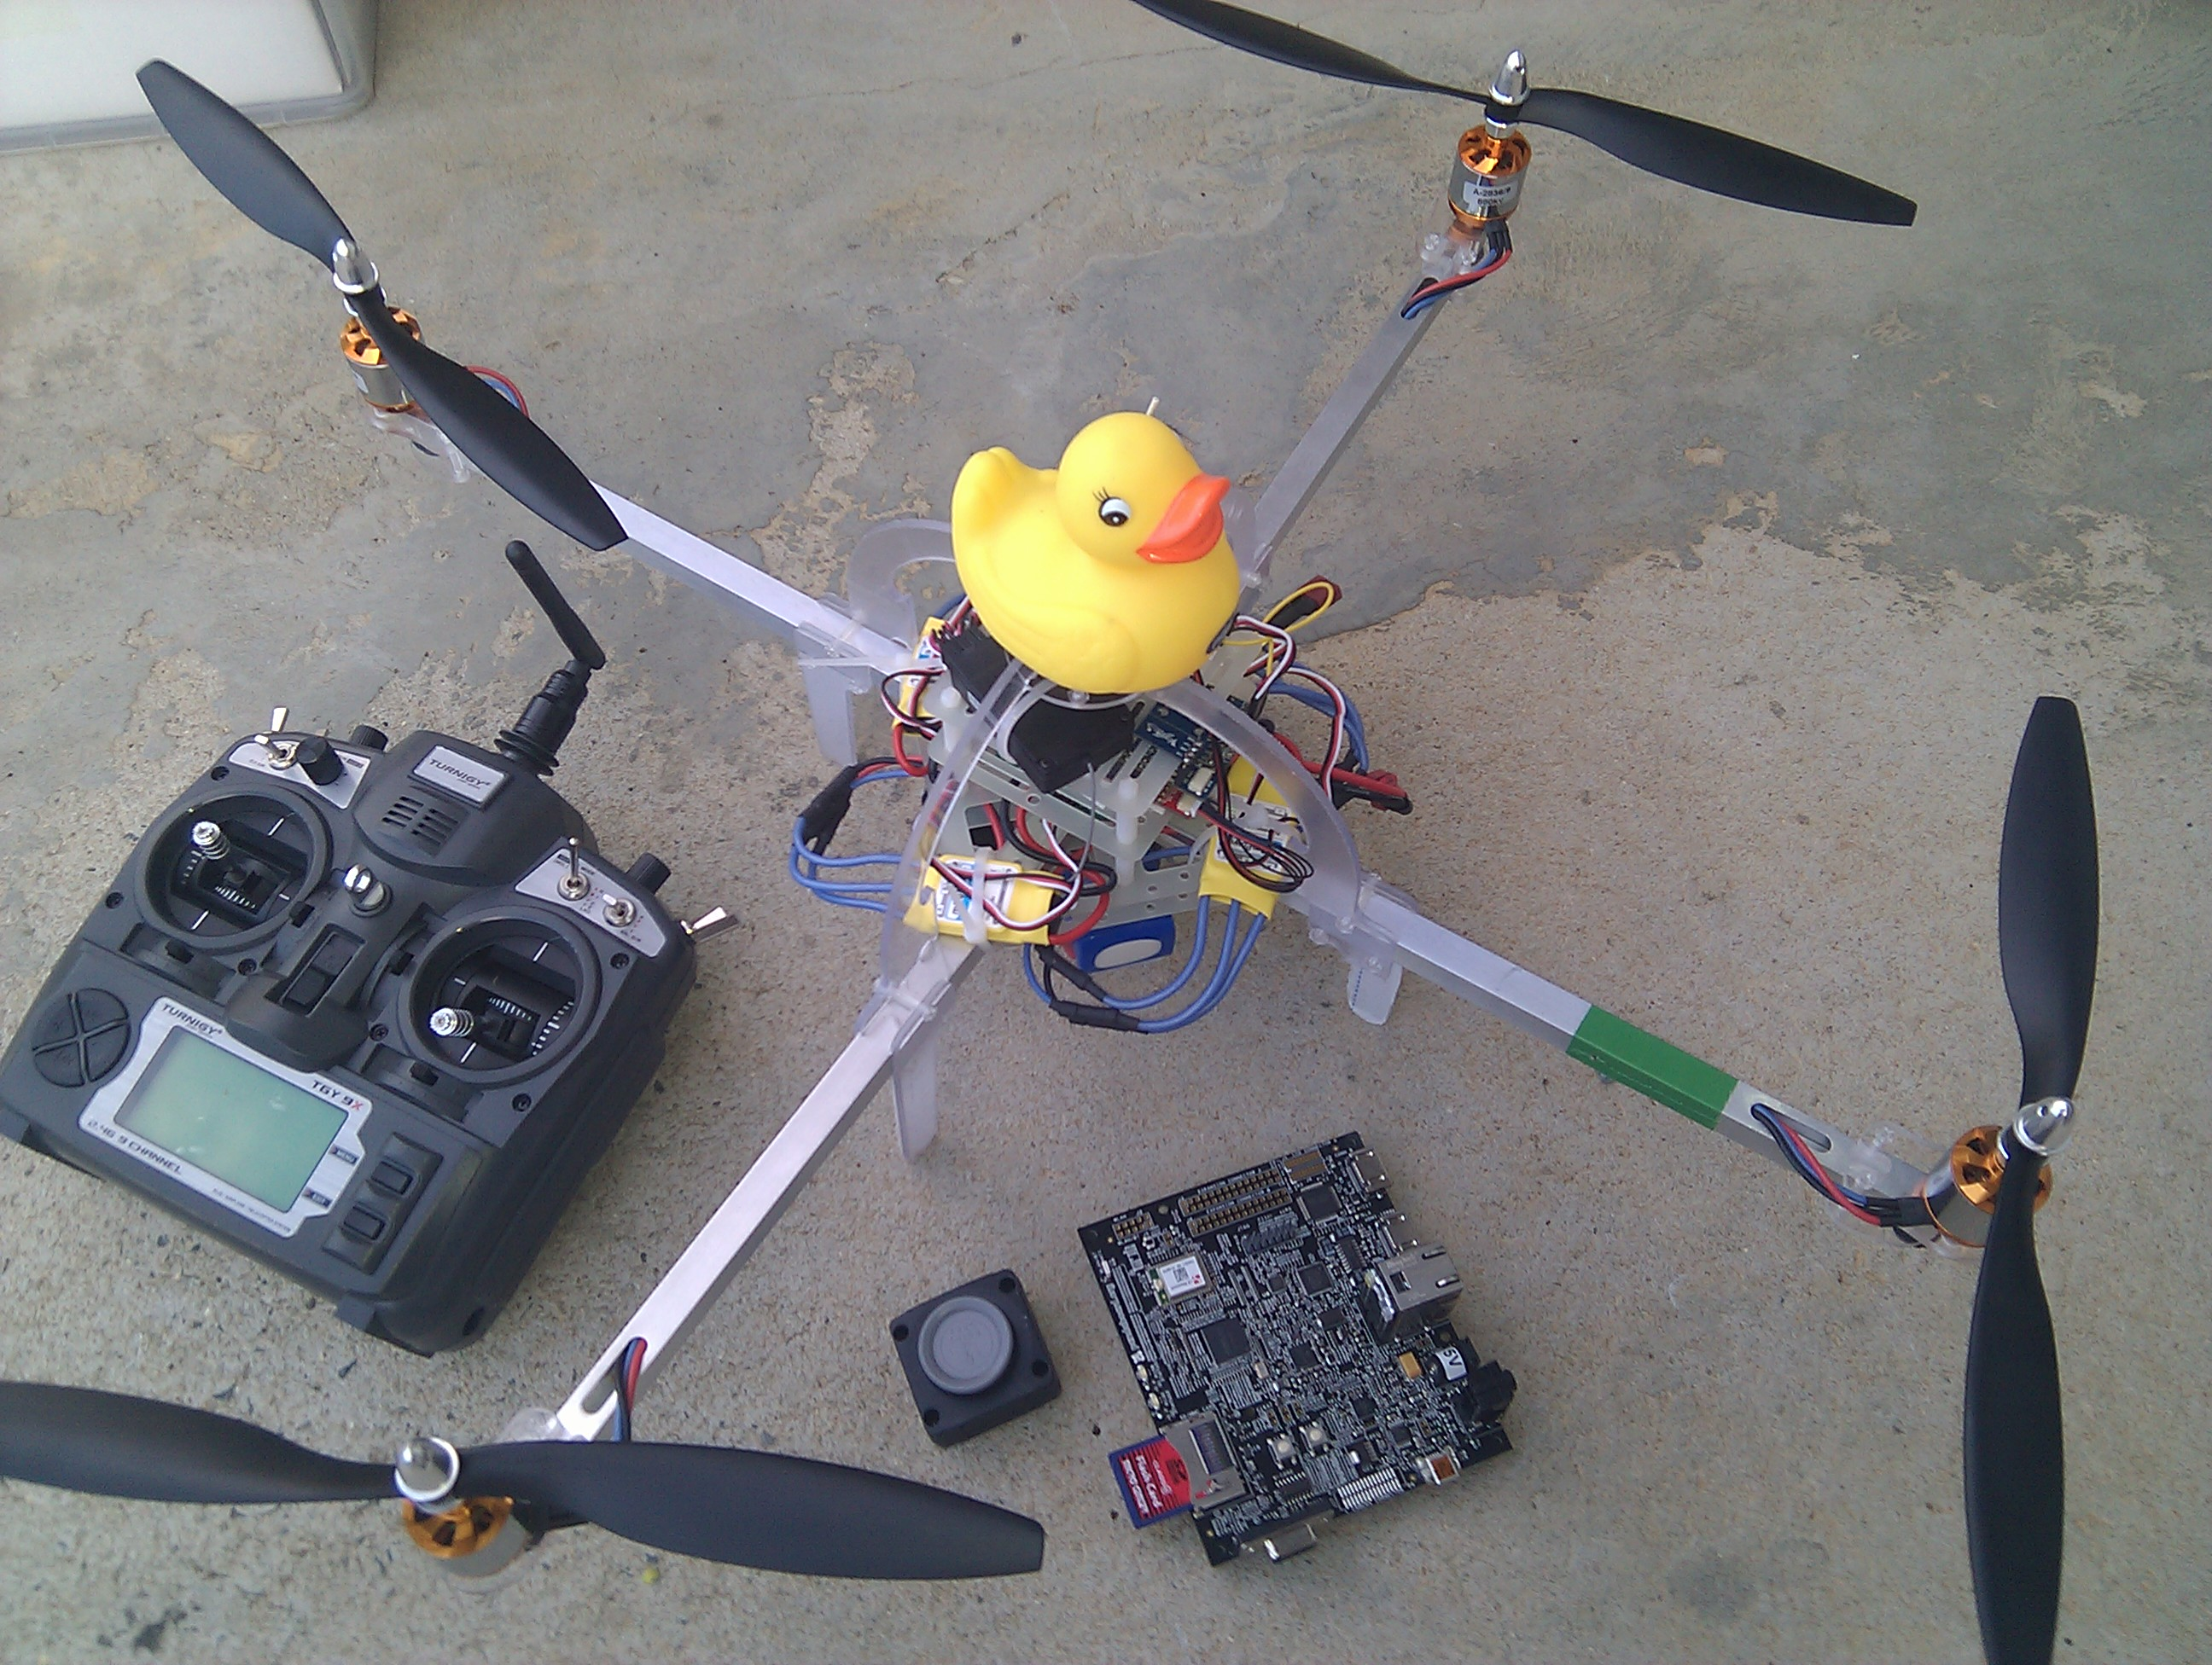
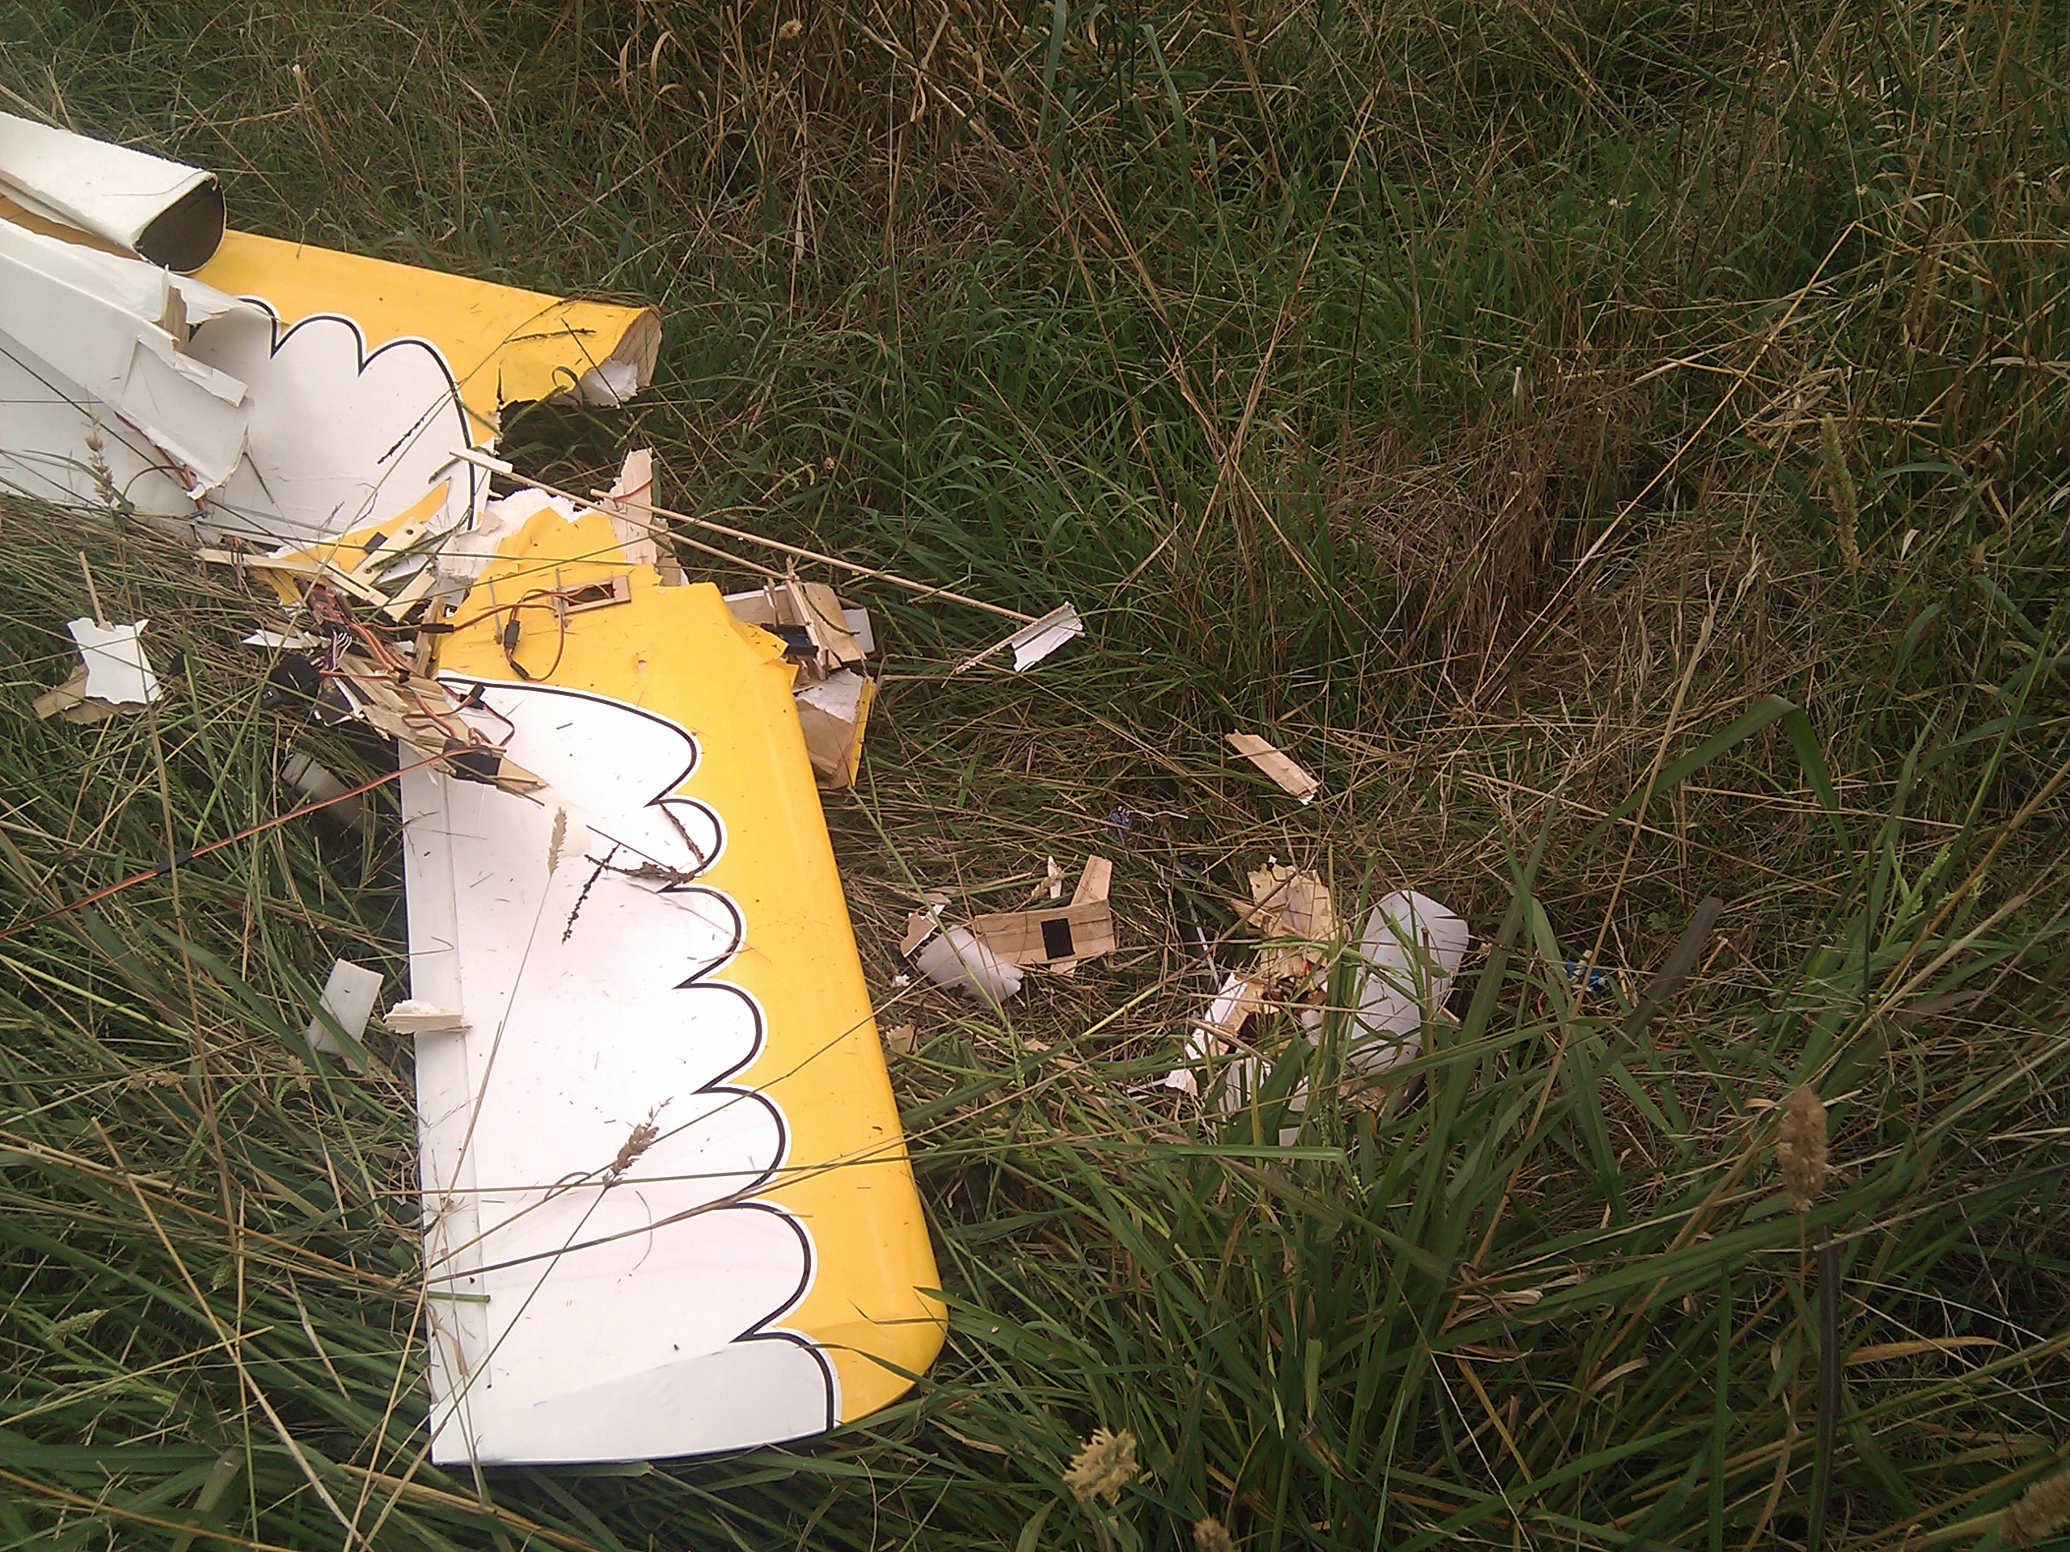
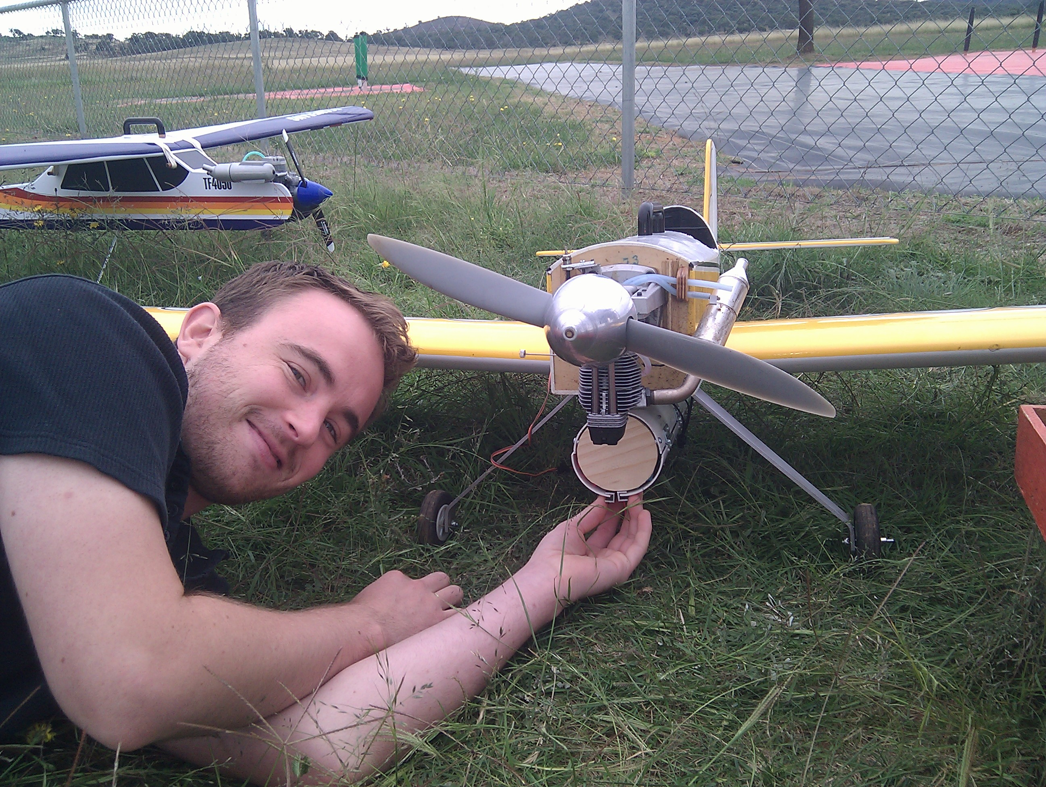
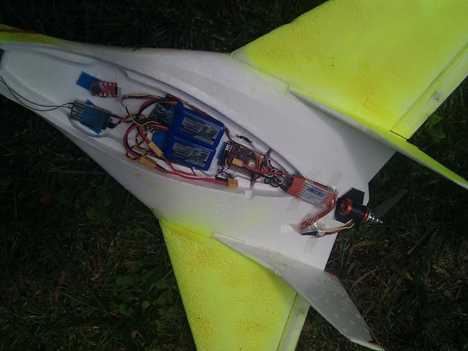
additional test aircraft...

Slide 9
Avionics
Servos
R/C
Receiver
Failsafe Controller
(arduino 328)
Primary Autopilot
(ArduPilotMega)
Backup Autopilot
(ArduPilotMega)
5.8GHz
Radio
SSD
Pandaboard
IR Camera
915MHz
Radio
Colour
Camera

Slide 10
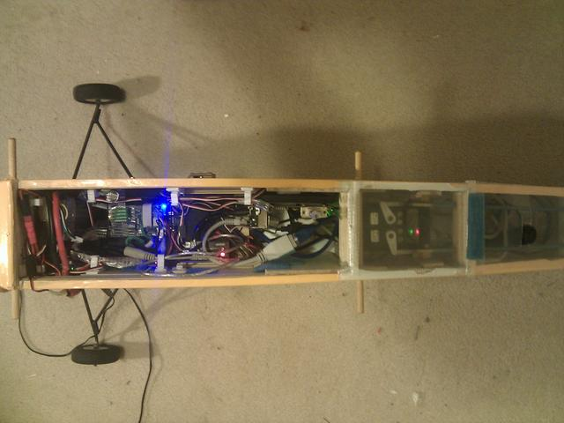
what it really looks like ...

Slide 11
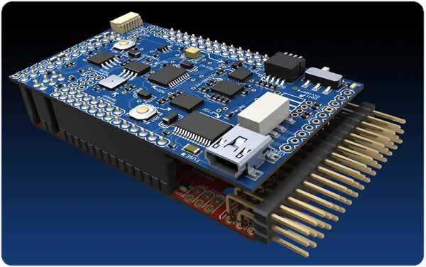
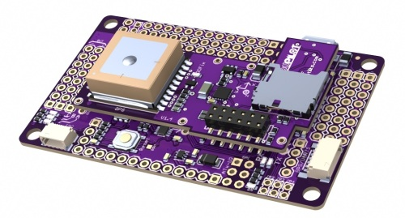
Autopilots
ArduPilot
  AVR2560 CPU
  8kb ram/256kb flash
  8 channel RC in/out
  4 UARTs
  3 axis gyro + 3 axis accel
  3 axis magnetometer
  barometer (altitude)
  GPS
  airspeed (pitot)
  sonar (low level altitude)
  Open hardware/open software

Slide 12
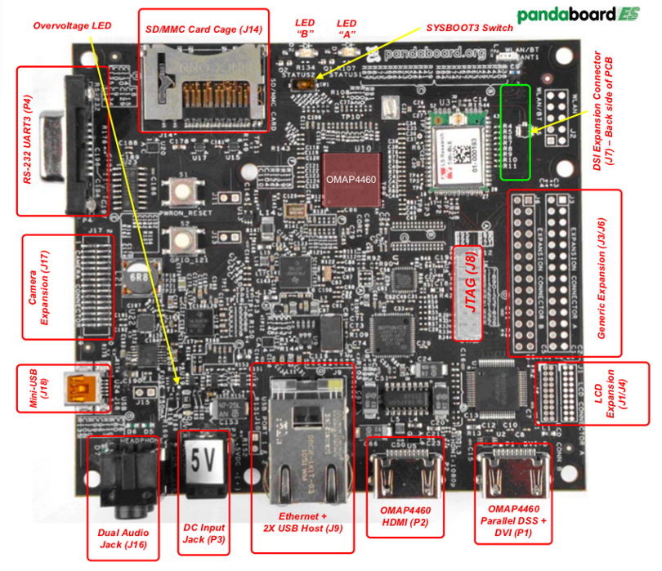
On-board computer
Pandaboard
  dual core 1GHz ARM
  SSD storage
  Ubuntu Natty
  mission control
  logging
  machine vision
  radio comms
  lots of python scripts!

Slide 13
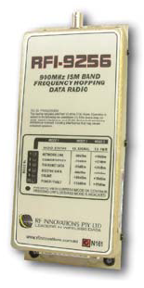
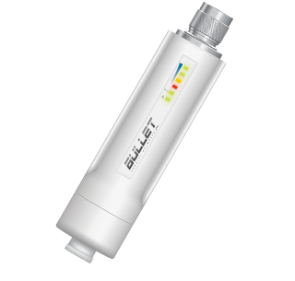
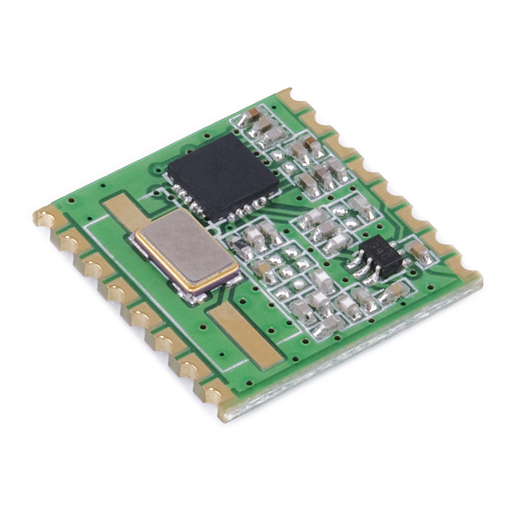
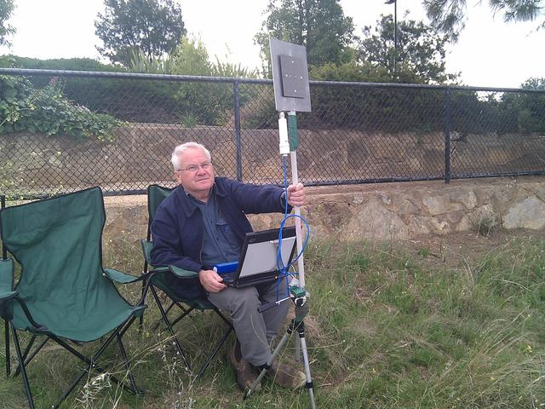
Radio links
High bandwidth link
  for images, control and high rate telemetry
  Ubiquity 5.8GHz bullet
  plus 5.8GHz amplifier
  ethernet bridge
  about 1.5Mbps
Low bandwidth link
  for telemetry/control
  needs to be very reliable
  RFI or HopeRF 915MHz
  9600 baud

Slide 14
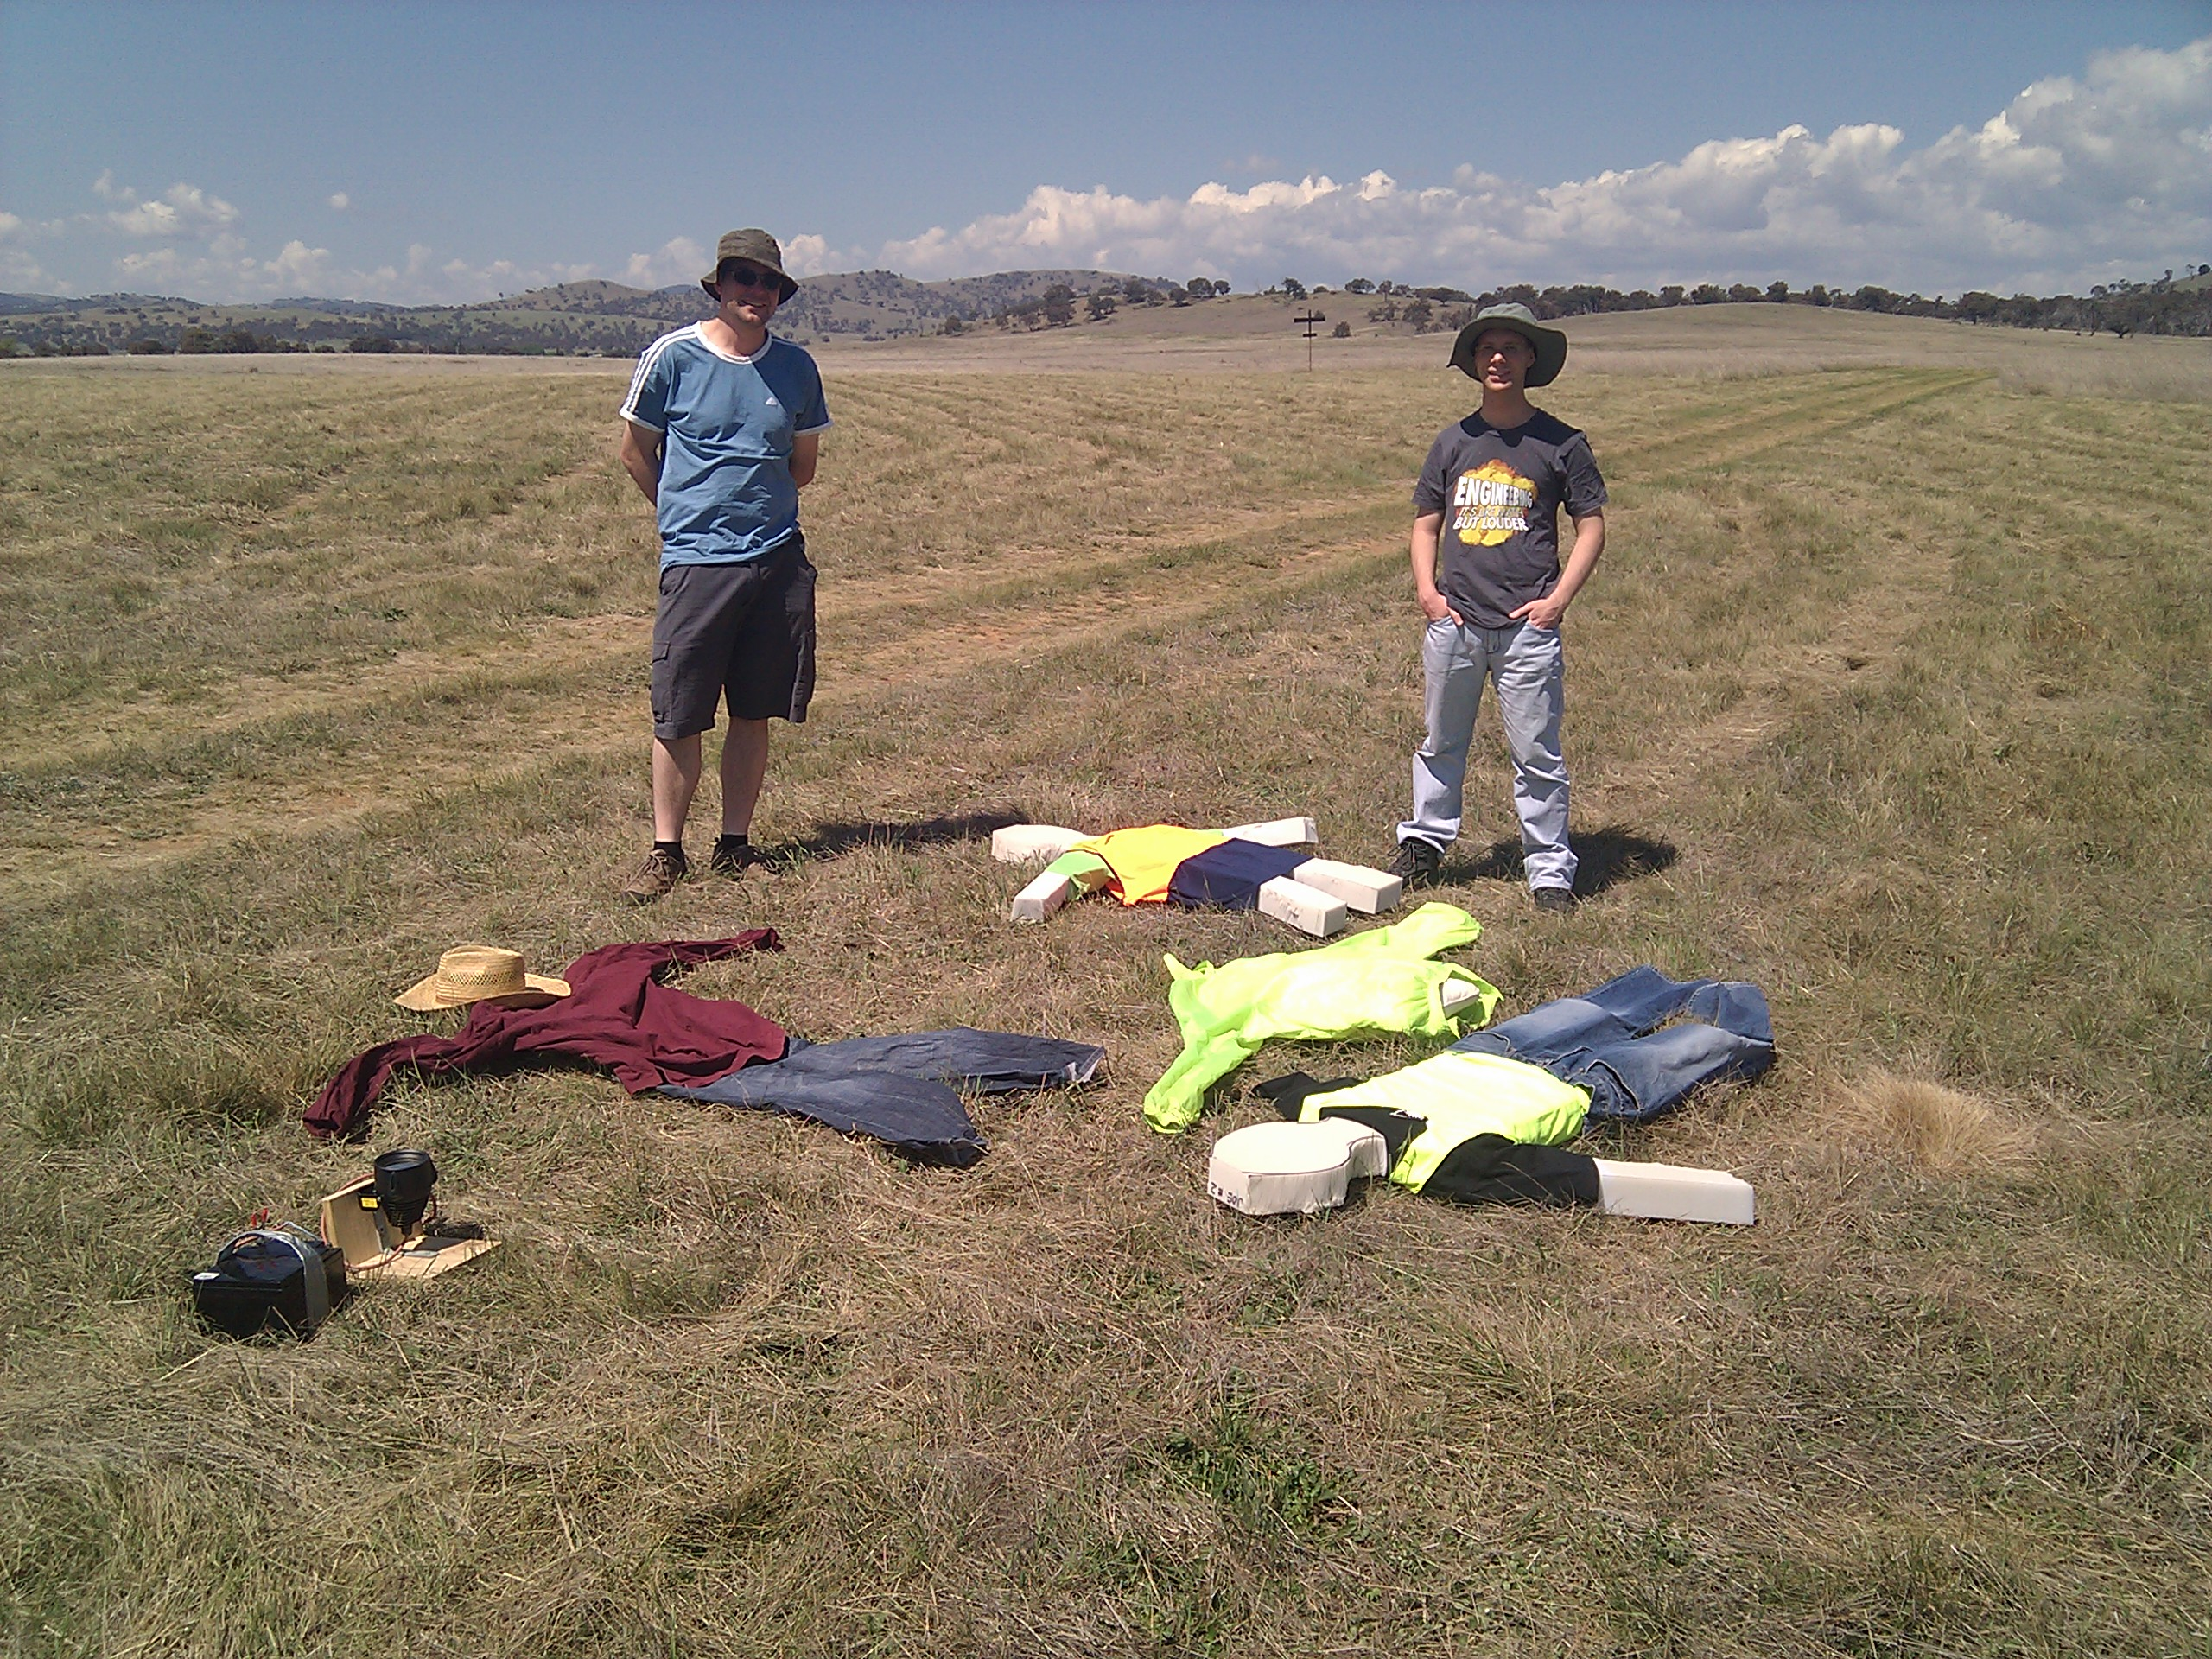
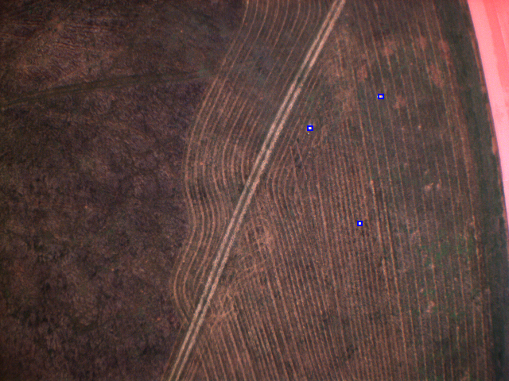
Computer Vision
Fast cameras
  PtGrey chameleon
  1 IR/grey, 1 colour
  8 frames/second
  ~70 microsec exposures
  point down with gyro driven servos
Drivers and software
  new driver based on DC1394
  image recognition in C
  geo-referencing in python
  needs to be fast!

Slide 15
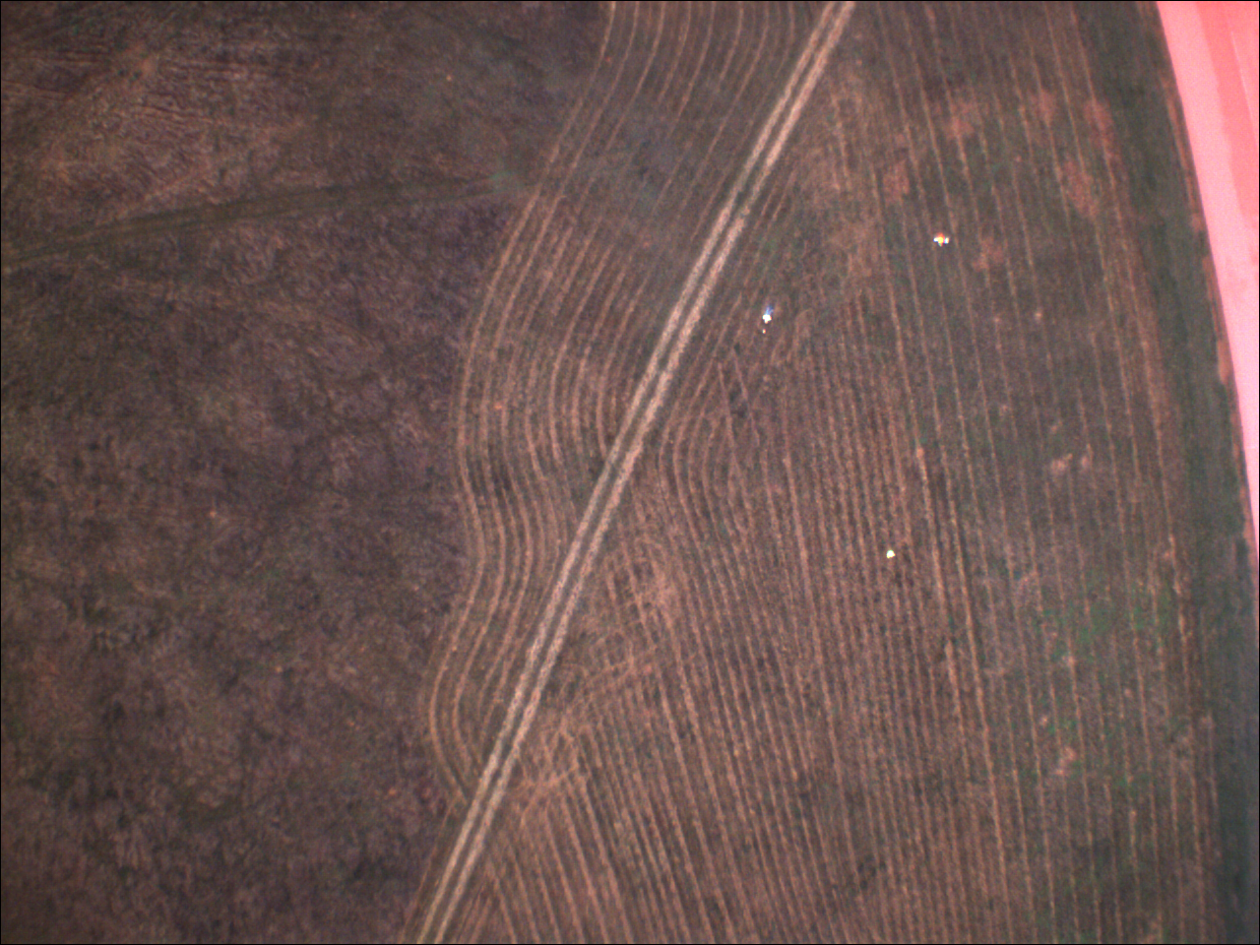
…debayered image

Slide 16
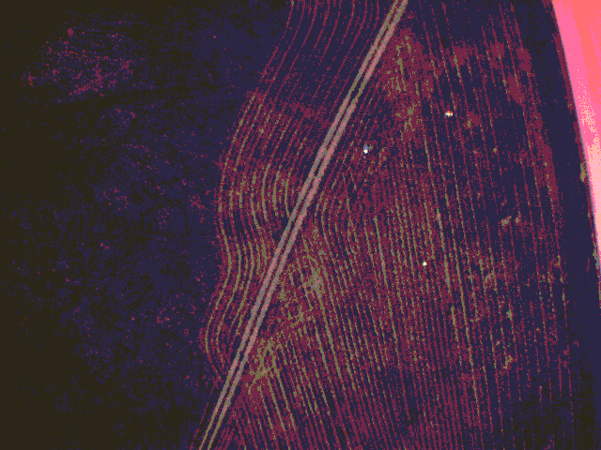
...RGB quantisation

Slide 17
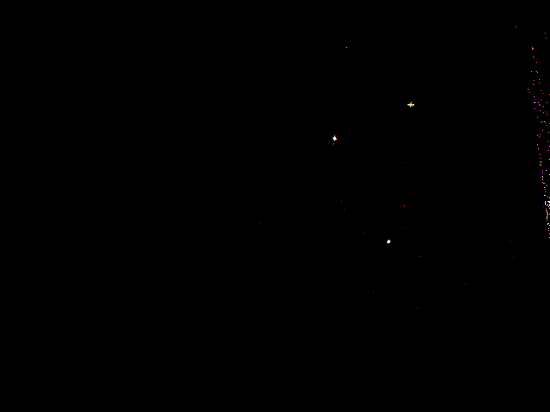
...thresholding

Slide 18

...neighbour expansion

Slide 19
final selection and geo-referencing

Slide 20
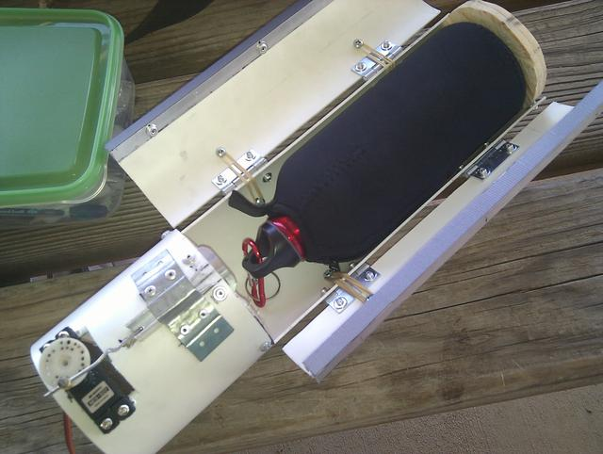
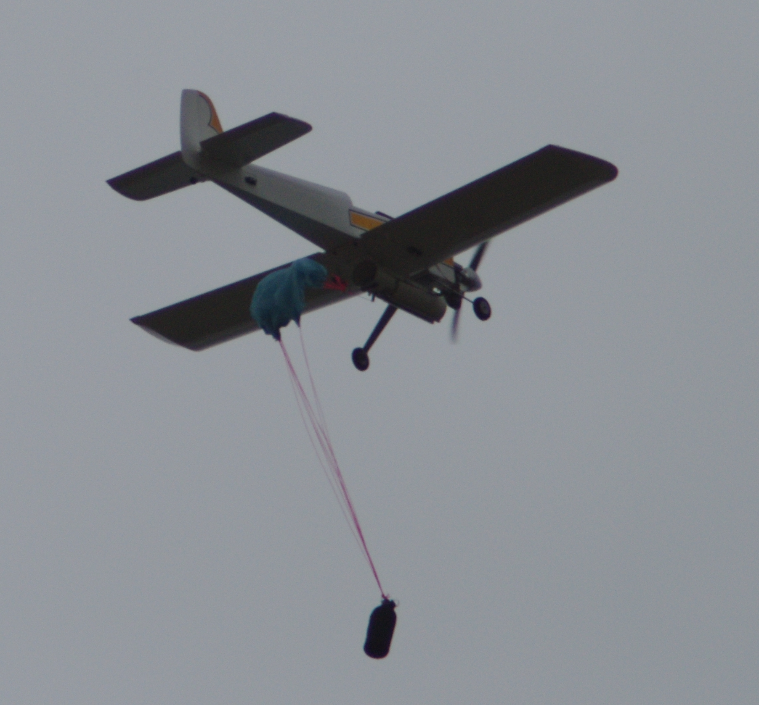
Bottle drop
Rescue package
  servo release mechanism
  GPS location from image recognition
  ballistic trajectory
  no early release, no breakage!
  repeatability is key
  small drogue chute

Slide 21
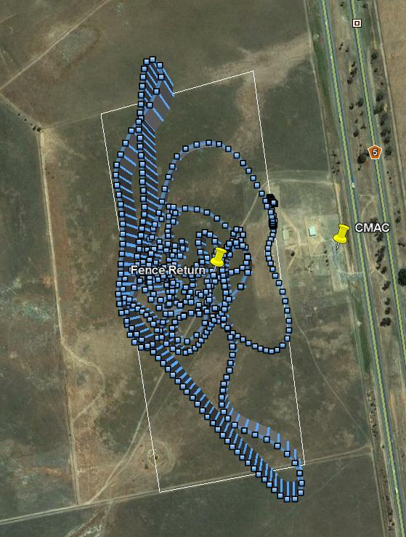
Geo-Fencing
GPS Fence
  11 point mission boundary
  failsafe activation on fence breach
    dive into the ground!
pilot training
  added as general ArduPilot feature
  flies back to return point on fence breach
  also min/max altitude

Slide 22
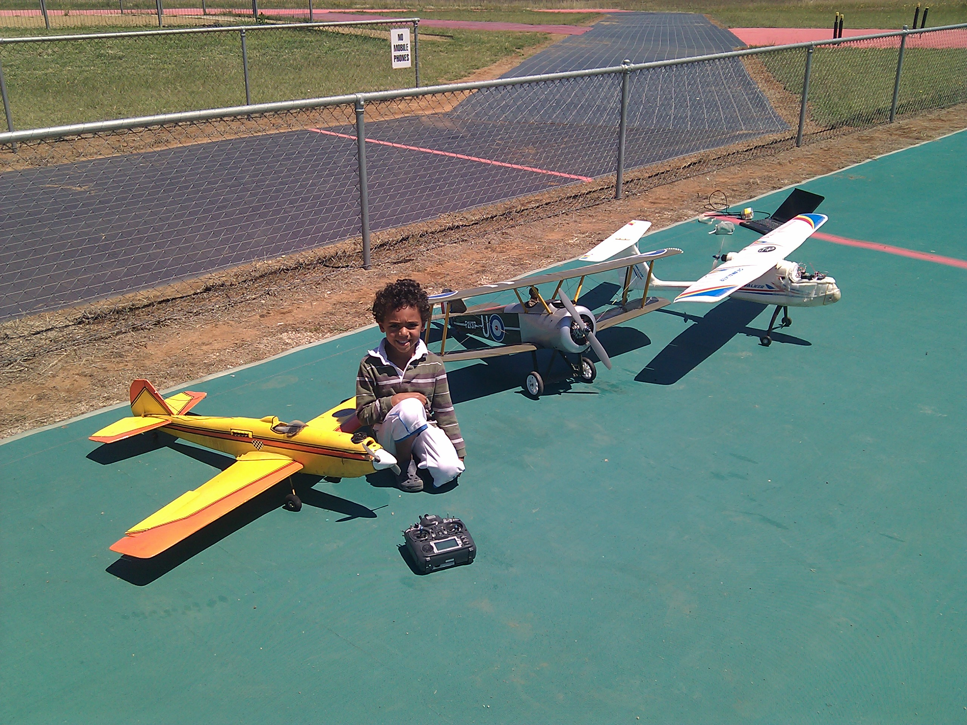
our youngest test pilot

Slide 23
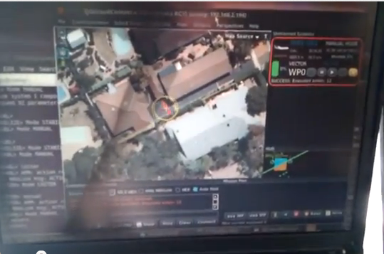
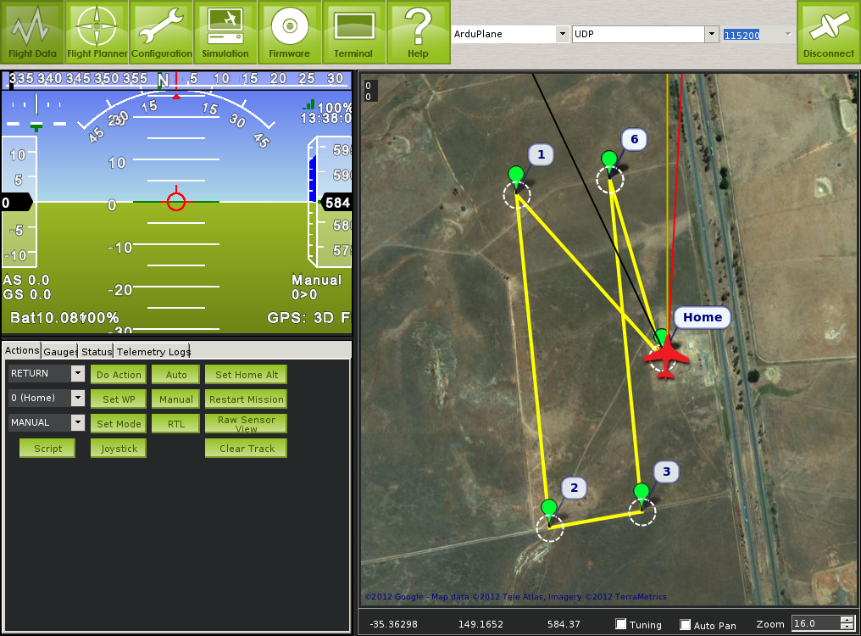
Ground station
Hardware
  old thinkpad
  sunlight readable display
Software
  MAVProxy (CLI)
  qgroundcontrol
  APM Planner

Slide 24
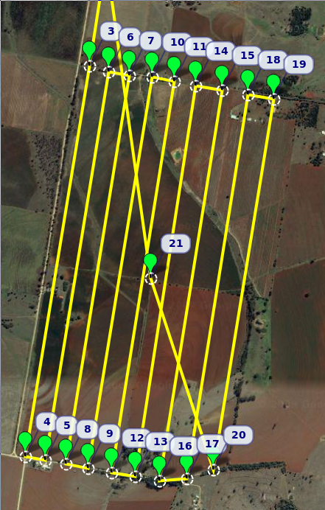
Search mission
Dynamic search
  base pattern of 150m wide strips
  50% overlap
  interleaved pattern
  30m/s cruise speed
  68km total flight
  controlled by python on pandaboard

Slide 25
Simulation and regression testing
Extensive simulation framework
  HIL (hardware in the loop) and
  SIL (software in the loop)
Python simulation framework
  connects to C++ simulation of autopilot board
  register level simulation of sensors
  JSBSim flight simulation backend at 1kHz
  python physics simulation for multicopters
Automatic regression testing
  runs on every git commit at http://autotest.diydrones.com/

Slide 26

MAVLink protocol
Speciality protocol
  designed for autopilots and ground stations
  auto-generated compact code from XML (python and C)
  wide range of tools
    analysis and graphing
    playback into sim

Slide 27
More information
Lots more info if you want it!
  http://www.canberrauav.com/
  http://www.diydrones.com/
  http://autotest.diydrones.com/
  http://photos.tridgell.net/v/CanberraUAV/

